Slide 1

Are hot dogs sandwiches?
Joanne, Kaitlyn & Victoria

Slide 2
Motivation & Hypothesis
The topic of whether a hot dog is a sandwich has been widely debated by people around the globe for ages.
To come to an answer for this age old question, we decided to poll the student population of UVA to see their thoughts.
Prior to the investigation, the class hypothesis was that:
Less than ½ of full-time, undergraduate, UVA students believe a hot dog is a sandwich

Slide 3
Data
Data was collected via a Google Form, sent out to friends of class DS 4002, section two.
Total Responses: 76
Questions:
Are you a full-time undergraduate UVA student?
Choices: Yes, No
What year are you?
Choices: 1st, 2nd, 3rd, 4th
Do you believe a hotdog is a sandwich?
Choices: Yes, No

Slide 4
Analysis Plan
Cleaning Data:
Downloaded Google Form data as .csv
Drop Timestamp column (automatically collected when filling out Google Form)
Drop any rows where students answered “no” to “Are you a full-time undergraduate UVA student?”
Change all data types to str for analysis purposes
Data Analysis and Visualization:
Examine overall responses, responses by class year, and sample distribution by class year
Plot results via bar and circle graph

Slide 5
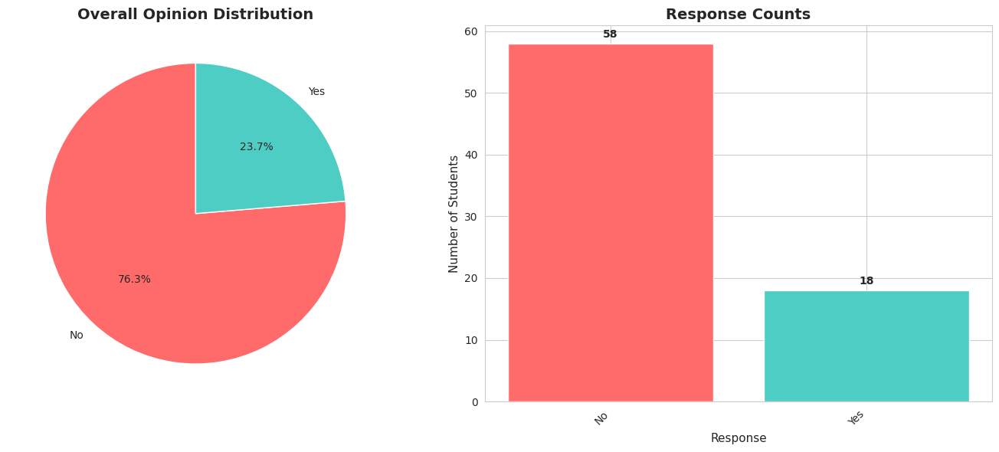
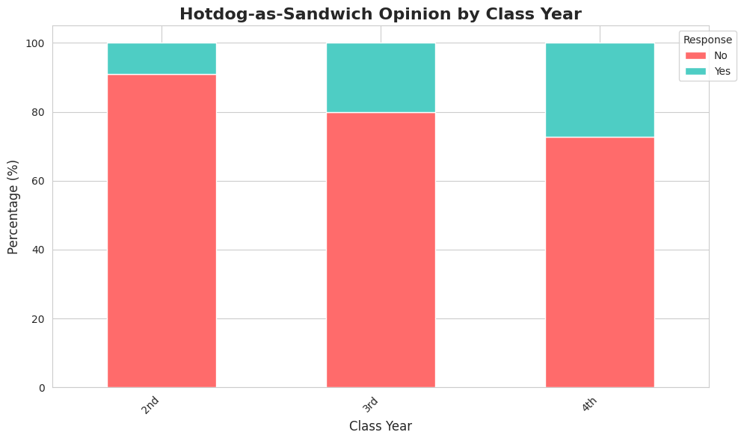
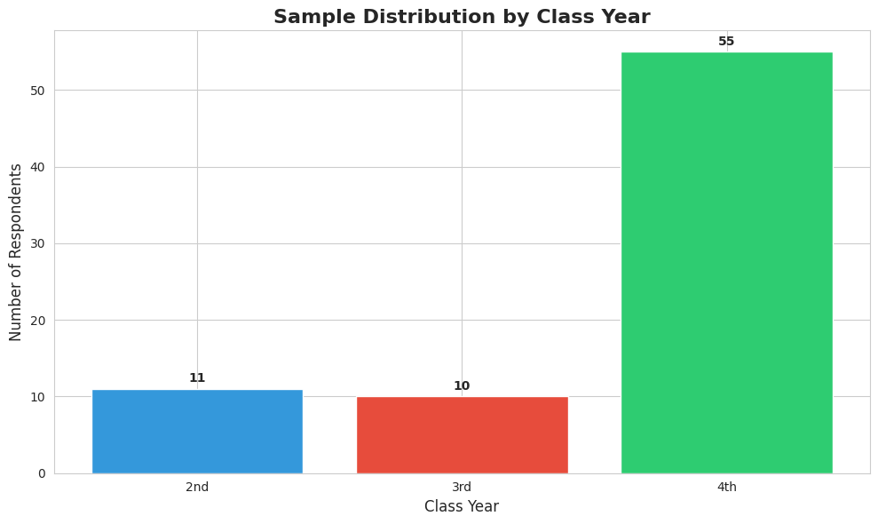
Results & Findings
Results highlight the disproportionate rate of 4th years and the underrepresentation of 1st, 2nd and 3rd years.
We can also examine how the vast majority (76.3%) of students polled believed hot dogs were not sandwiches, further strengthening and even exceeding our hypothesis.

Slide 6
Biases
1. SAMPLING BIAS
Total responses: 76
Year distribution:
2nd: 11 (14.5%)
3rd: 10 (13.2%)
4th: 55 (72.4%)
2. RESPONSE BIAS / NON-RESPONSE BIAS
Total sample size: 76
Potential issues:
• Self-selection bias: Only students who chose to respond are included
• Students with strong opinions may be more likely to respond
• Survey distribution method may have reached certain demographics more
Results may not be generalizable to all UVA undergraduates
3. COVERAGE BIAS
Survey limited to full-time undergraduate UVA students in DS4002 class, not general UVA population
Excludes:
• Students outside this classroom
• Students who didn't see/access the survey during the 2 day period (wednesday and thursday)
This may not reflect the true UVA undergraduate population distribution.

Slide 7
Next Steps
To increase validity of this study, we would recommend:
Increasing sample size by distributing the form (via link) to the largest quantity of students possible.
With this, we can investigate on a wider and more diverse population, ranging from 1st to 4th years in all different majors.
Add more questions in the poll
It would be interesting to investigate trends in how people with different genders or ethnicities (for example) would answer the research question

